Slide 1

CREDIT CARD
FRAUD DETECTION
BY : YUGANDHAR IPPILI

Slide 2

AGENDA
PART 1 : OBJECTIVE
PART 2 : DATA UNDERSTANDING
PART 3 : EXPLORATORY DATA ANALYSIS
PART 4 : COST BENEFIT ANALYSIS
PART 5 : METHODOLOGY

Slide 3

OBJECTIVE
To build a fraud detection model helping banks to identify credit card frauds and be vigilant enough to reduce losses incurred due to such unauthorized transactions by the fraudsters.

Slide 4
PROBLEM STATEMENT
Finex is a leading financial service provider based out of Florida, US offering a wide range of products and business services to customers through different channels, ranging from in-person bankingand ATMs to online banking.Over the last few years, Finex has observed thata significantly largenumber of unauthorised transactions are being made, due to whichthe bank has been facinga huge revenue and profitability crisis. Manycustomers have been complaining aboutunauthorised transactions being made through their credit/debit cards. Now, Finexis also not really equipped with the latest financial technologies, and is becoming difficult for the bank to track these data breaches on time to prevent furtherlosses.

Slide 5
DATA UNDERSTANDING
Consisting of two datasets i.e.,fraud train and fraud test. Further, it's been combined.
The combined dataset i.e., cred fraud df has 1852394 rows and 22 columns (after dropping unnamed column though it is irrelevant).
1842743 (99.5%) transactions are non-fraudulent and 9651 (0.5%) transactions seemtobe fraudulent - Reason of high data imbalance.

Slide 6
EXPLORATORY DATA
ANALYSIS

Slide 7
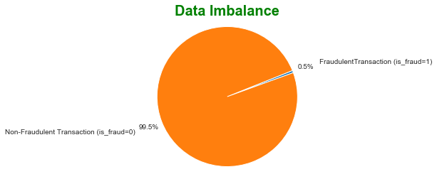
99.5%oftransactionsare non-fraud while rest 0.5% refers to fraud.

Slide 8
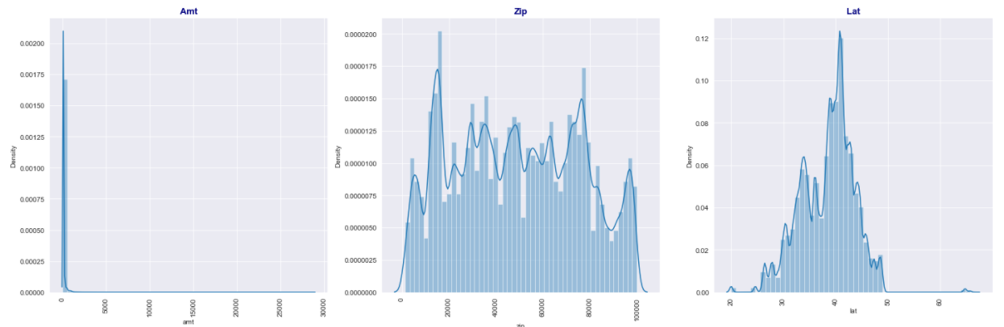
UNIVARIATE ANALYSIS
NUMERICAL COLUMNS

Slide 9
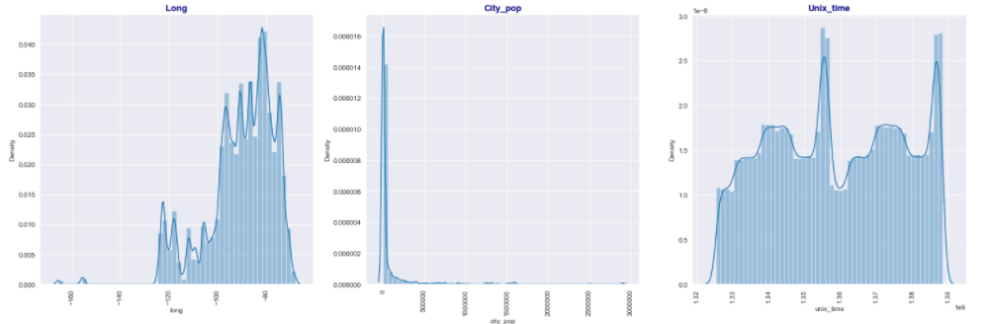
UNIVARIATE ANALYSIS
NUMERICAL COLUMNS

Slide 10
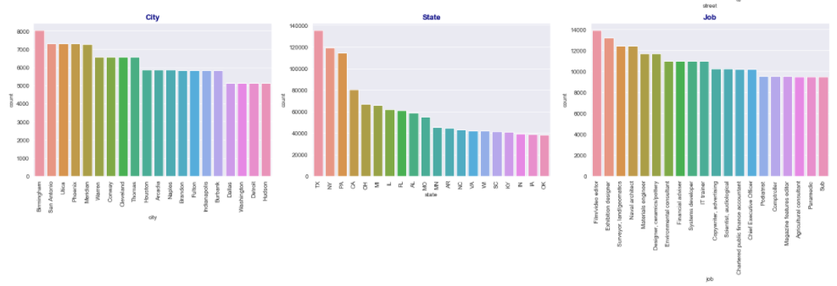
UNIVARIATE ANALYSIS
CATEGORICAL COLUMNS

Slide 11
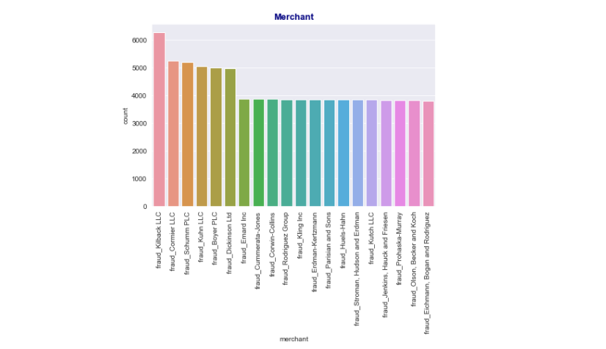
UNIVARIATE ANALYSIS
MERCHANT DISTRIBUTION

Slide 12
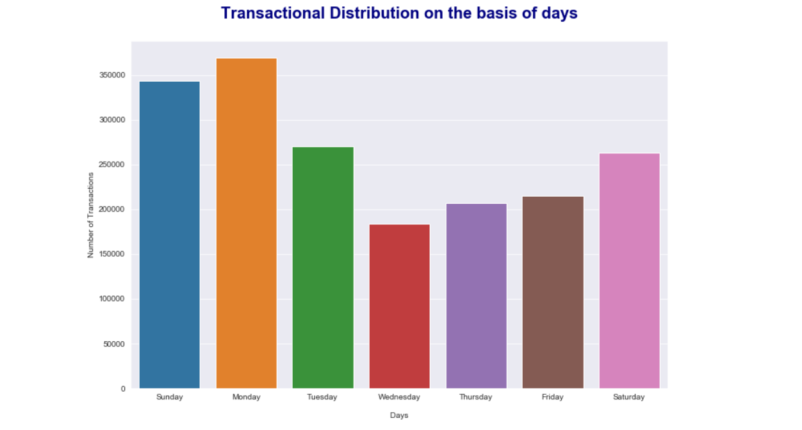
UNIVARIATE ANALYSIS
DAYS WISE DISTRIBUTION

Slide 13
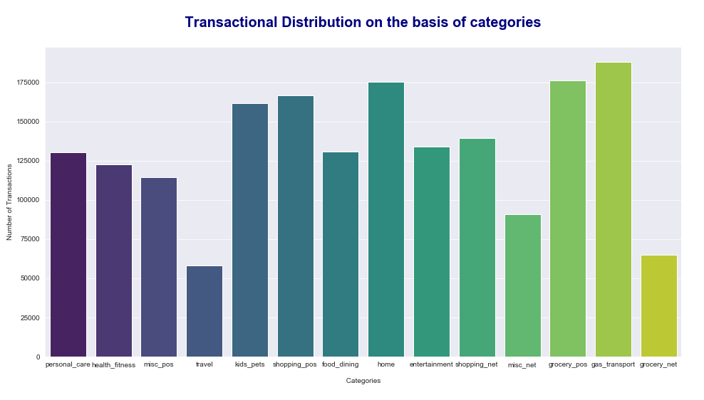
UNIVARIATE ANALYSIS
CATEGORY WISE DISTRIBUTION

Slide 14
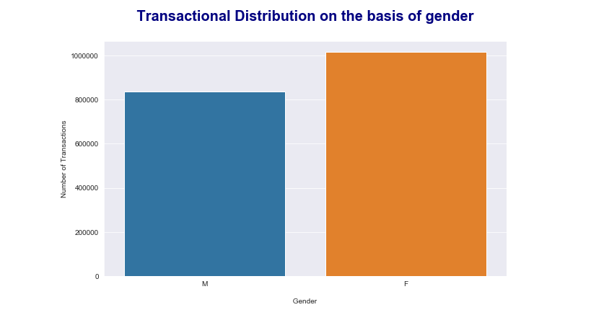
UNIVARIATE ANALYSIS
GENDER WISE DISTRIBUTION
MALE
FEMALE

Slide 15
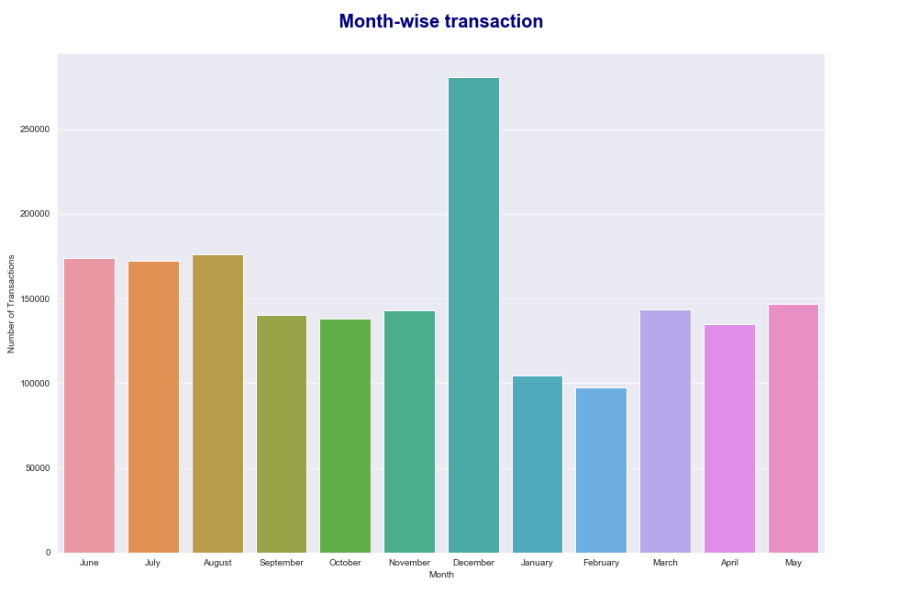
UNIVARIATE ANALYSIS
MONTH WISE DISTRIBUTION

Slide 16
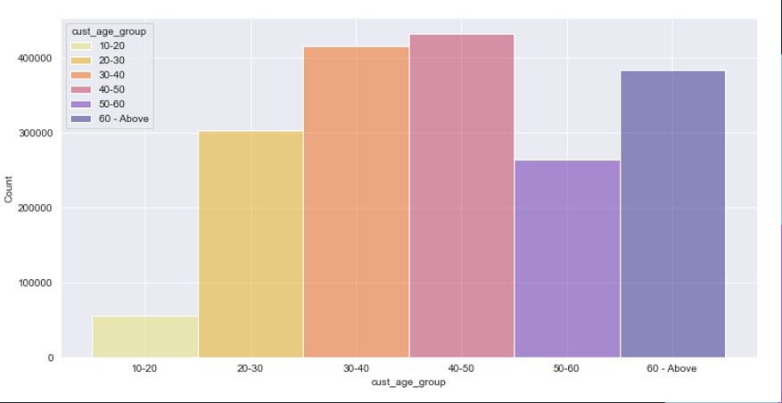
UNIVARIATE ANALYSIS
AGE GROUP WISE DISTRIBUTION

Slide 17
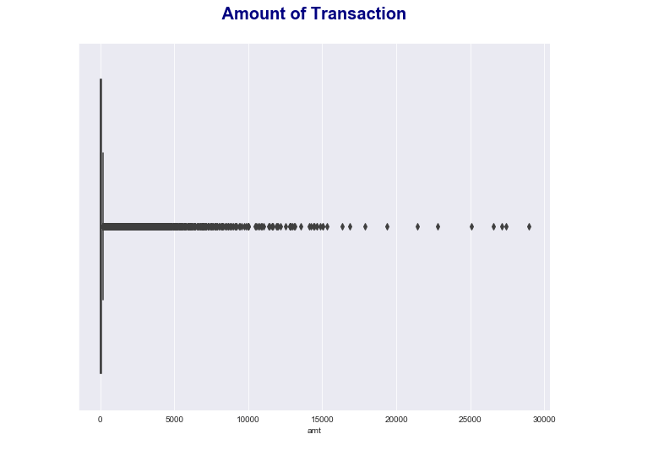
UNIVARIATE ANALYSIS
AMOUNT OF TRANSACTION

Slide 18
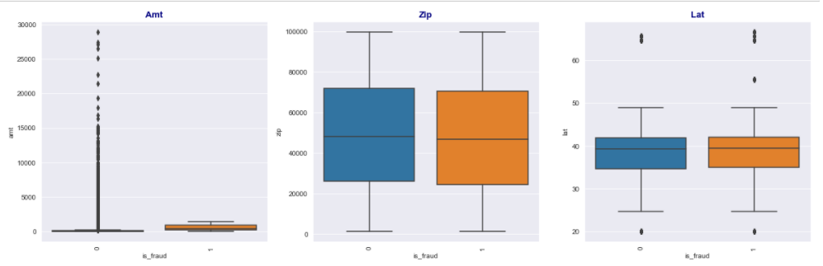
BIVARIATE ANALYSIS
NUMERICAL COLUMNS

Slide 19
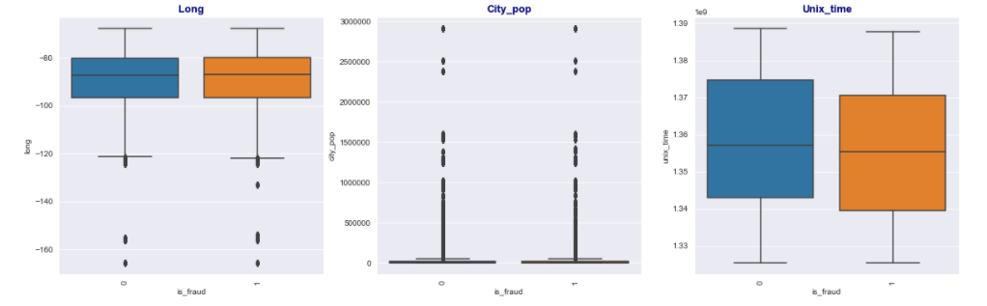
BIVARIATE ANALYSIS
NUMERICAL COLUMNS

Slide 20
SUMMARY
Columns like city_pop and amt are highly skewed.
Maximum transactions were done on Sunday and Monday.
Categories like home,grocery_pos and gas_transports has highest amount of transactions above 175000.

Slide 21
SUMMARY
Most of the transactions are been done by female customers.
250000+ transactions were done in December month.
Majority of the transactions done by customers are of 30-50 years age group.

Slide 22
SUMMARY
Most of the transactions are been done by the customers having job as Film video editor, Exhibition designer and surveyor of land or geomatics.
Majority of transaction is done from the Kilback LLCmerchant.
A heavy amount of non-fraudulent transactions has been done.

Slide 23

COST-BENEFIT ANALYSIS

Slide 24
An average number of transactions per month detected as fraudulent by the model: 1731.22
An average number of transactions per month that are fraudulent but not detected by the model: 21.14
Avg no. of transaction per month: 77183.08
Avg no. of fraudulent transactions per month: 402.12
Avg amount per fraudulent transaction: 530.66

Slide 25

ME
T
HODOLOGY

Slide 26

Data Scaling
and
SMOTE
Data
Cleaning
Dummy
Variables
1
3
5
7
2
4
6
Building a model along with hyper parameter tuning
Understanding data
Exploratory
Data Analysis
Test-Train
Split

Slide 27
Data Scaling
and
SMOTE
Data
Cleaning
Dummy
Variables
1
3
5
7
2
4
6
Building a model along with hyper parameter tuning
Understanding data
Exploratory
Data Analysis
Test-Train
Split

Slide 28
Oversampling is been done for adjusting the class distribution of a dataset. For that, SMOTE is used.
Different models like Logistic regression, Decison Tree and Random Forest Classifier were used.
Decision trees and random forest showed promising results with high accuracy, precision and recall. Helpful enough for the detection of fraudulent transaction.

Slide 29
Oversampling is been done for adjusting the class distribution of a dataset. For that, SMOTE is used.
Different models like Logistic regression, Decison Tree and Random Forest Classifier were used.
Decision trees and random forest showed promising results with high accuracy, precision and recall. Helpful enough for the detection of fraudulent transaction.

Slide 30
